Slide 1


Strategic Brand Storytelling: Crafting Compelling Narratives

Slide 2
Why Stories Matter?
•Humans are wired for stories
•Stories are more memorable than mere facts
•They build trust, emotional resonance, and collectivity

Slide 3
What is Brand Storytelling?
Beyond Marketing
Emotional Connection
Building Loyalty
Brand storytelling transcends traditional marketing by creating meaningful narratives rather than just selling features and benefits.
Stories trigger emotional responses that facts and figures cannot. They make your brand relatable and memorable.
Well-crafted stories transform customers into brand advocates who share your narrative with others.

Slide 4

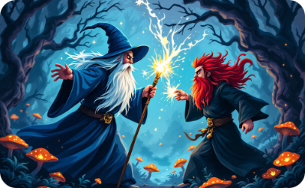


The Four Elements of a Good Story
Message
Conflict
Characters
Plot
What the story conveys
The struggle or problem at the heart of the story
Who the story is about and how they connect
How the story unfolds, step by step

Slide 5
Before we tell a brand story, we need to get the basics right:
Strategic Brand Storytelling Model
Who are you?
1
Define your brand identity
2
Why are you here?
Articulate your purpose and mission
What do you do?
3
Showcase your products/services and value proposition
4
How do you make a difference?
Highlight your impact and emotional connection
Where are you going?
5
Share your vision and long-term narrative
Fog, Budtz, Munch, and Blanchette (2010), Storytelling: Branding in Practice, Springer

Slide 6








Identifying Your Brand's Unique Story
Your Differentiator
What makes your brand uniquely valuable
Audience Alignment
How your story connects with customer values
Brand Personality
Your consistent voice and character traits
Origin Story
The authentic founding narrative that drives you

Slide 7





Brand Story Framework: Your brand, the hero
Character (Consumer)
Challenges
Your Brand (The Hero) Enters
Transformation
Customer's current state with an unmet need or challenge.
Obstacles they face on their path to resolution.
The improved life or solution your brand provides.
How your product or service helps overcome challenges.

Slide 8
The Must Have's of a Powerful Brand Story:
•Stories must reflect real values
•Consistency across touchpoints is crucial (across media and across distribution channels)
•Avoid manipulation or over-branding

Slide 9
12 Brand Archetypes and Myths
Archetype
Core Desire
Brand Voice
Example Brands
The Innocent
Safety, happiness, optimism
Simple, honest, wholesome
Dove, Coca-Cola
The Everyman (or Regular Guy/Girl)
Belonging, equality
Friendly, down-to-earth
IKEA, Target
The Hero
Courage, mastery, challenge
Empowering, bold, inspirational
Nike, FedEx
The Outlaw
Liberation, rebellion
Disruptive, provocative
Harley-Davidson, Diesel
The Explorer
Freedom, discovery
Adventurous, independent
Jeep, Patagonia
The Creator
Innovation, self-expression
Imaginative, visionary
Apple, Adobe
The Ruler
Control, order, leadership
Authoritative, refined
Mercedes-Benz, Rolex
The Magician
Transformation, vision
Inspiring, mysterious
Disney, Tesla
The Lover
Intimacy, beauty, passion
Sensual, warm, emotional
Chanel, Victoria’s Secret
The Caregiver
Service, compassion
Reassuring, nurturing
Johnson & Johnson, UNICEF
The Jester
Fun, spontaneity, joy
Playful, humorous
M&M’s, Old Spice
The Sage
Wisdom, truth, understanding
Thoughtful, analytical
Google, BBC

Slide 10
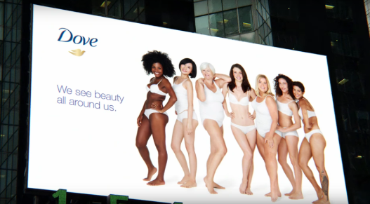
The Innocent Brand Archetype: Dove
Challenge to Beauty Standards & Foster Self-Confidence
Brand Voice
Simple
Launched in 2004, Dove's "Campaign for Real Beauty" challenged traditional beauty standards by featuring real women of diverse backgrounds to foster body positivity.
Honest
Wholesome

Slide 11

Telling the same story over time is no easy feat
But consistency, authenticity, and relevancy are key to success…Dove continues to challenge traditional notions of beauty in the context of Artificial Intelligence:

Slide 12

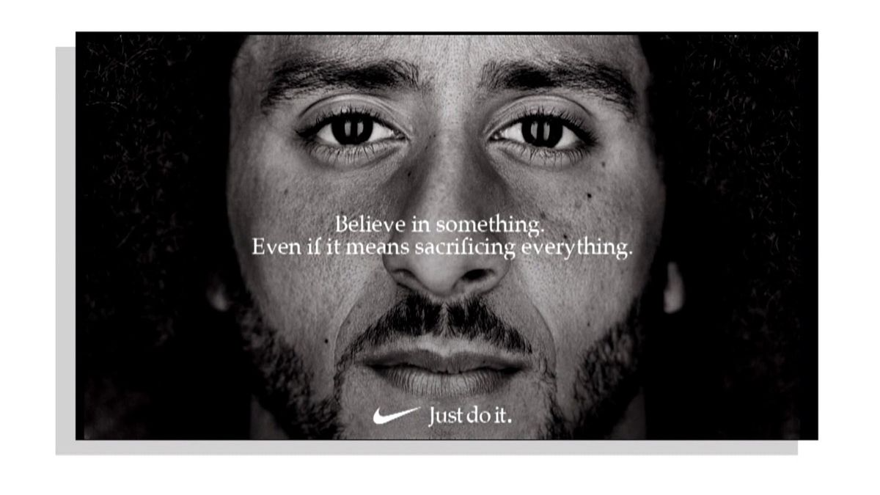
Case Studies: Successful Brand Storytelling
Airbnb: Belong Anywhere
Transformed from accommodation platform to global community by sharing host and traveler stories. User-generated content drives their narrative.
Patagonia: Environmental Activism
Built brand loyalty through unwavering commitment to environmental stories. Their documentary-style approach highlights authentic conservation efforts.
Nike: Just Do It and Courage to Support Justice
Consider how Nike engaged in brand activism by featuring politically polarizing Colin Kaepernick as the spokesperson for the 30th anniversary of its iconic "Just Do It" campaign.

Slide 13
Partners in Brand Stories:
We think the company/senior management controls the narrative, but we have partners all over the world, shaping the story (both in a good and bad ways)
Employers
Channel members
Consumers

Slide 14





Storytelling Across Multiple Channels
Website
Immersive, detailed version of your core narrative with rich media elements.
Social Media
Bite-sized, visual story fragments that maintain brand voice while adapting to platform culture.
Physical Spaces
Tangible experiences that bring your story to life through environment and personal interactions.
Direct Communications
Personalized continuations of your narrative that deepen individual customer relationships.

Slide 15




Implementing Strategic Brand Storytelling
Define Your Core Narrative
Identify your foundational story elements
Map Customer Touchpoints
Plan how story unfolds across journey
Create Content System
Develop guidelines for consistent execution
Measure and Refine
Continuously improve based on feedback

Slide 16

Measuring the Impact of Your Brand Story
Metric
Purpose
Tools
Engagement Rate
Measures audience interaction with story content
Social analytics, CRM data
Brand Sentiment
Gauges emotional response to your narrative
Sentiment analysis, surveys
Conversion Lift
Shows story impact on purchase behavior
A/B testing, attribution models
Share of Voice
Tracks narrative reach compared to competitors
Media monitoring platforms

